Slide 1
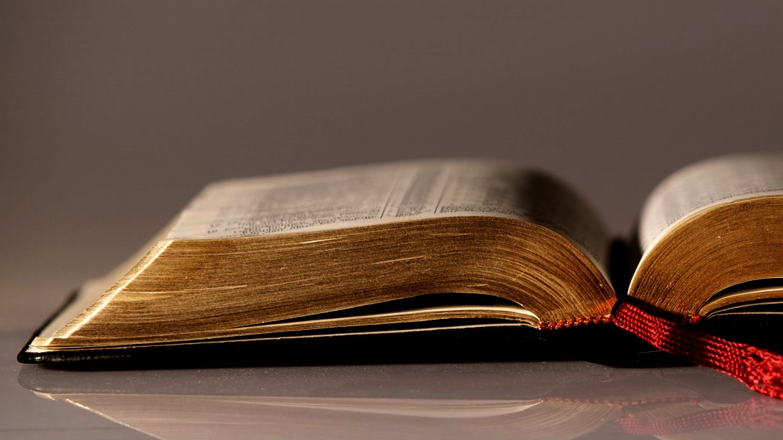
Welcome to
Our Sunday School
We’ll start at 9:07
visit OurSundaySchool.com for more about our class

Slide 2
Today’s class (pages 150-154)
Philippians 2:17-18

Slide 3
Philippians 2:17-18 (CSB)
But even if I am poured out as a drink offering on the sacrificial service of your faith, I am glad and rejoice with all of you. In the same way you should also be glad and rejoice with me.

Slide 4
Today’s class (pages 150-154)
Philippians 2:17-18

Slide 5
Drink offering
Old Testament
Utensils: Exodus 25, 29-30, 38
When: Leviticus 23; Numbers 4; 6; 15:5, 7, 10; 28:9, 10, 15; 29
New Testament
Paul: Philippians 2:17; 2 Timothy 4:6
Jesus: Luke 22:20; John 19:34

Slide 6
Today’s class (pages 150-154)
Philippians 2:17-18

Slide 7
leitourgia →
leitourgia → liturgy

Slide 8
Today’s class (pages 150-154)
Philippians 2:17-18

Slide 9
Prayer Time
Write down your prayer requests (on the Weekly Update or in the comments)
Lean in, engage, and pray for someone not with you
Go worship

Slide 10
Today’s class (page 16)
Preparing for Philippians 1:1-30
Pray with others
Hear with others
Think with others
Study with others In class, as a table
Share with others
Invite others After class
In class, as a class

Slide 11
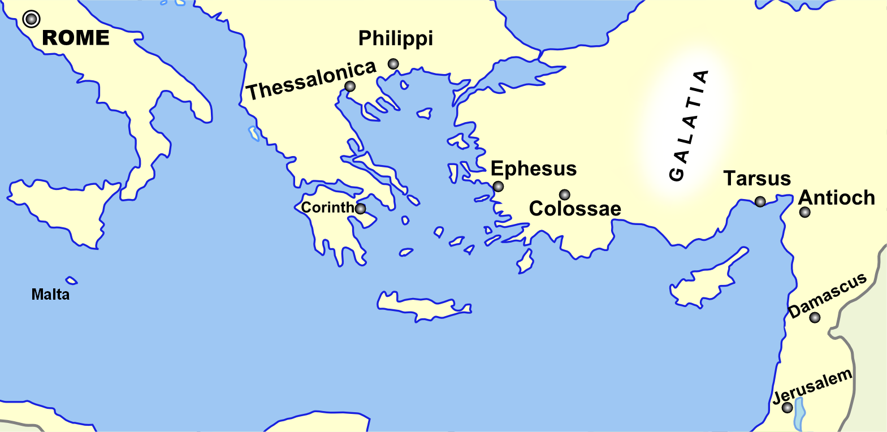
Monozigote. (2012). Broad Overview of Geography Relevant to Paul of Tarsus [Map]. Wikipedia.

Slide 12
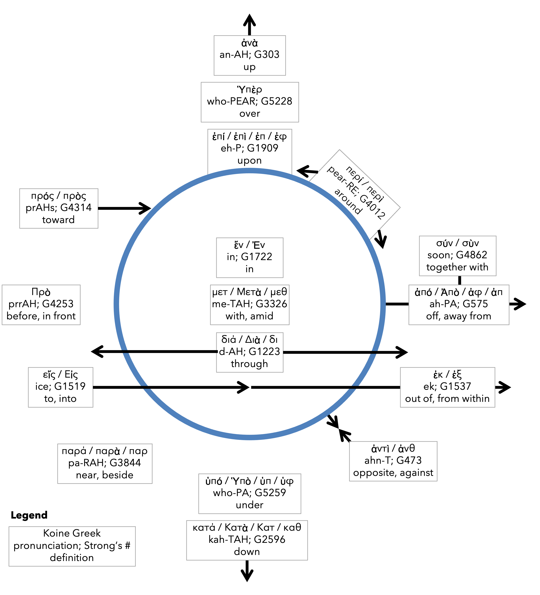
Preposition circle (page 11)

Slide 13
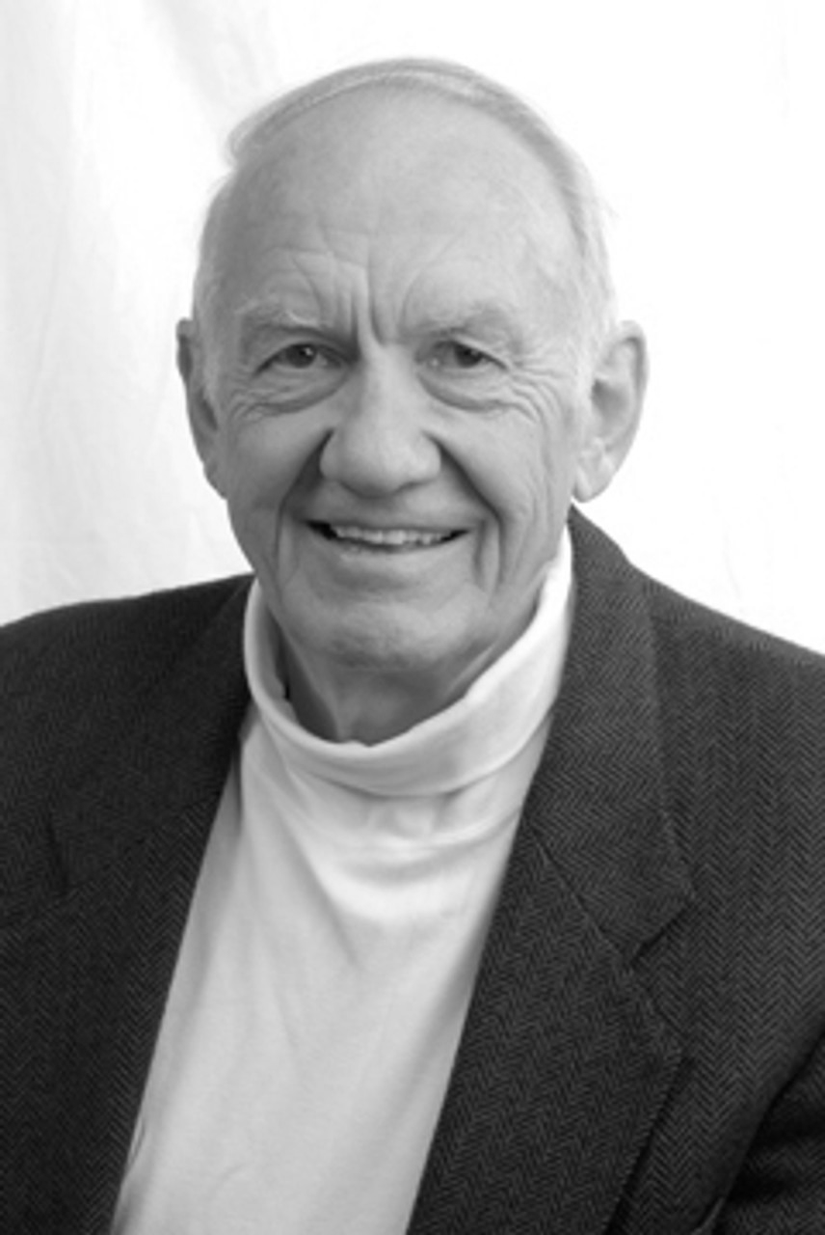
Dr. Gordon Fee Quote

Slide 14
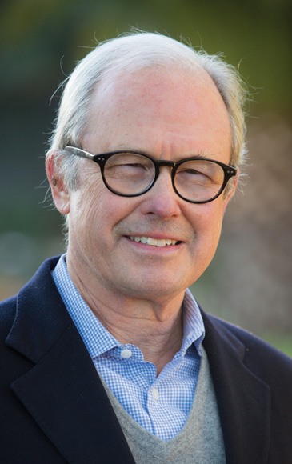
Dr. G. Walter Hansen Quote

Slide 15
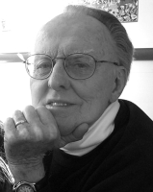
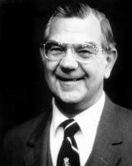
Dr. G. F. Hawthorne & Dr. Ralph P. Martin Quote

Slide 16
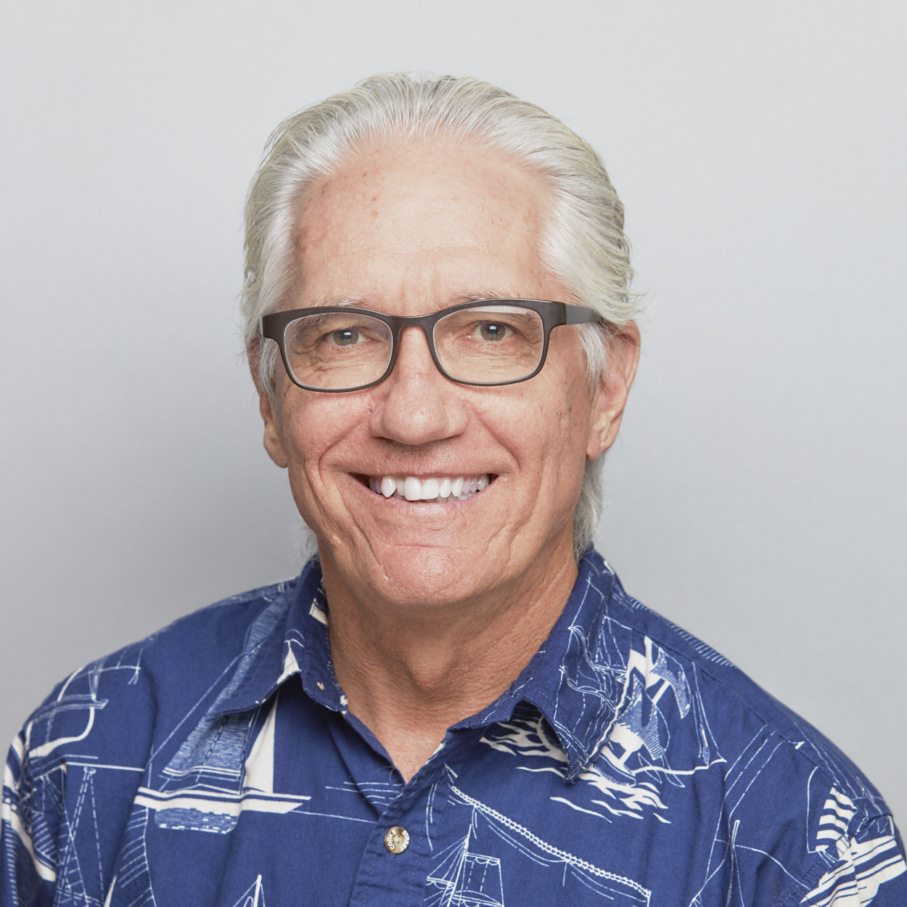
Dr. Joe Hellerman Quote

Slide 17
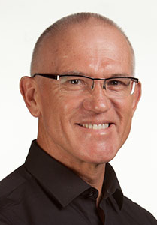
Dr. Mark Keown Quote

Slide 18
Dr. Ralph P. Martin Quote

Slide 19
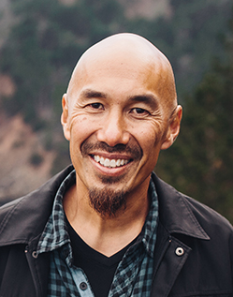
Dr. Tony Merida & Frances Chan Quote

Slide 20
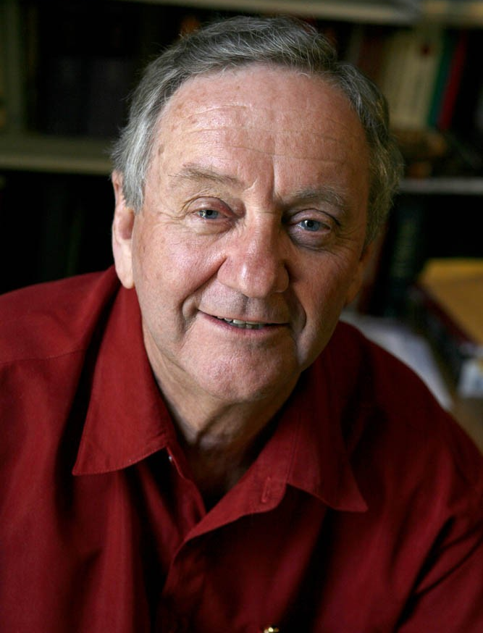
Dr. Peter T. O’Brien Quote

Slide 21
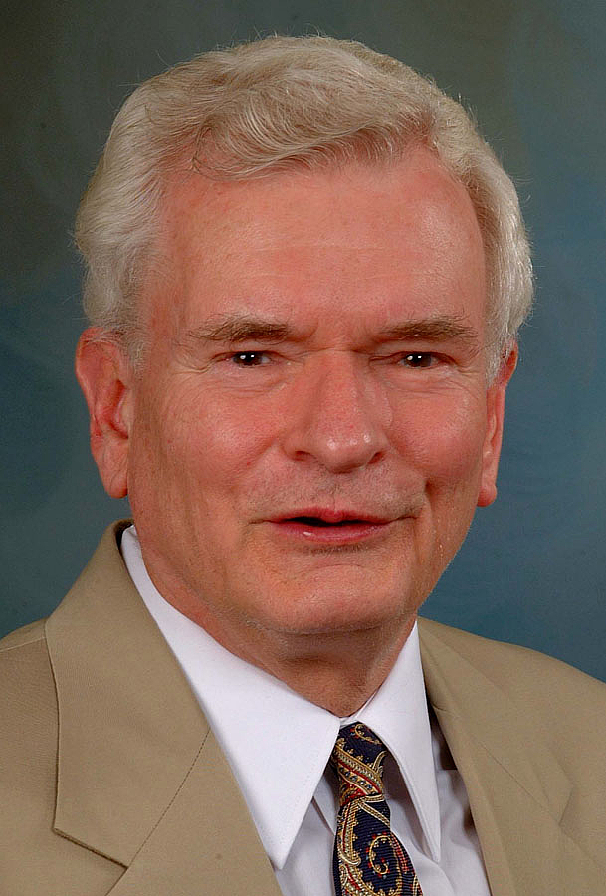
Dr. John Reumann Quote

Slide 22
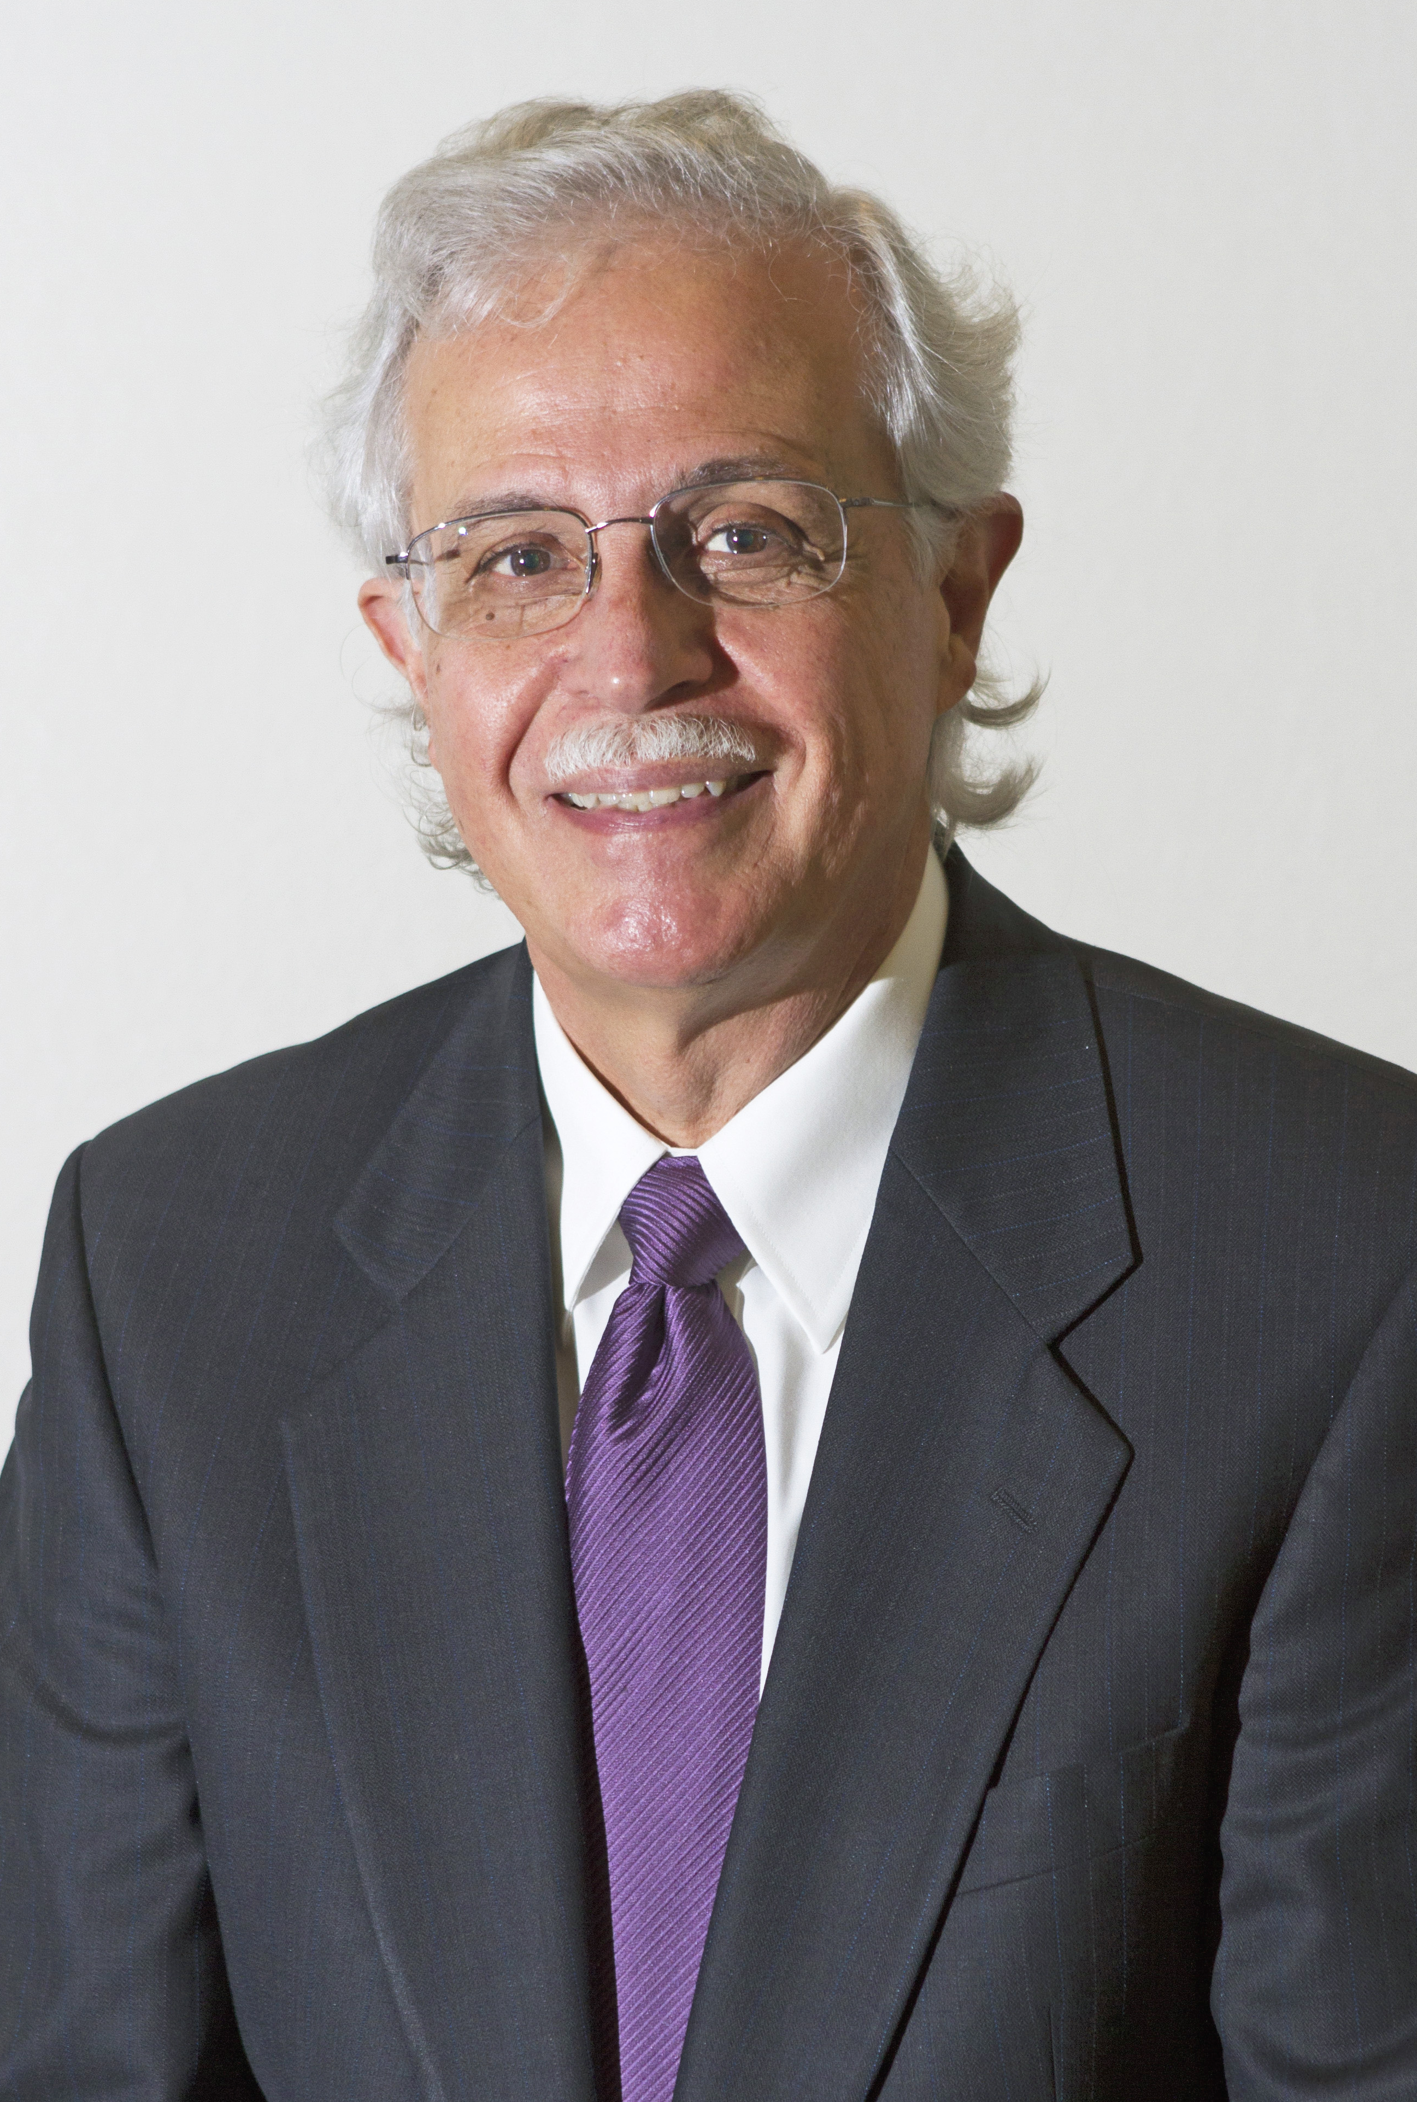
Dr. Moises Silva Quote

Slide 23
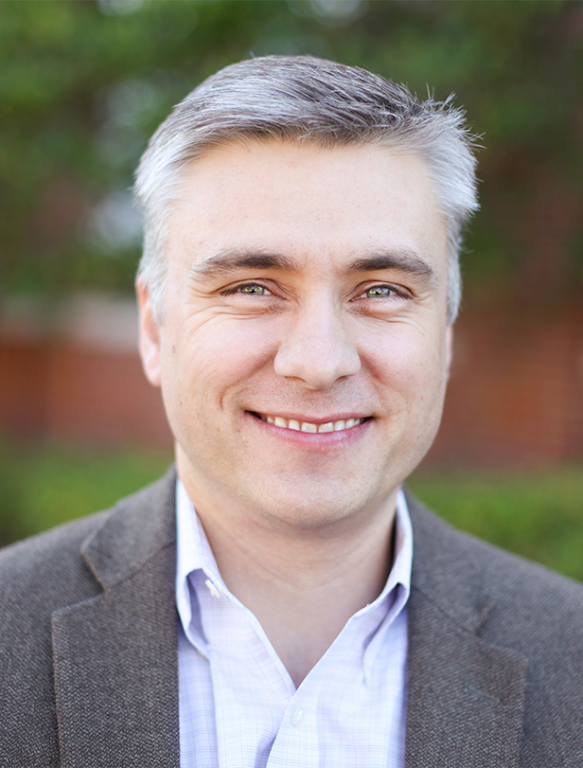
Dr. David T. A. Strain Quote

Slide 24
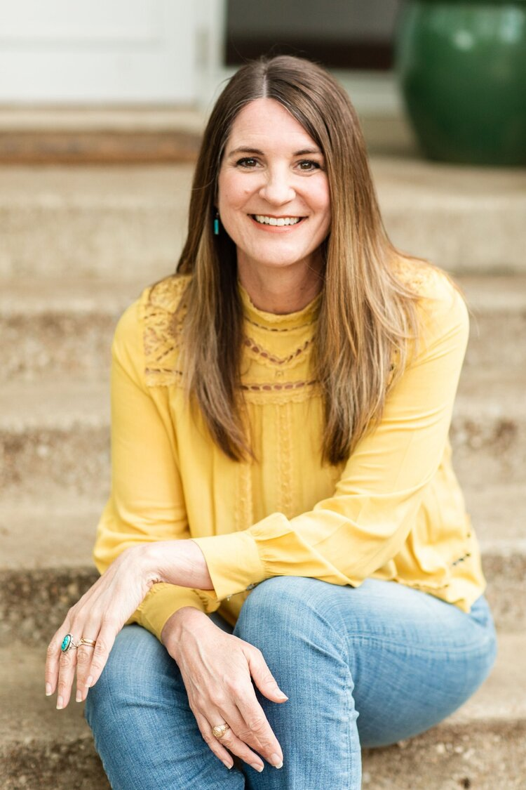
Jen Wilkin Quote

